Slide 1

Bedah dan Analisa Java Library iText-2.1.7
Pair Project #1
Andi & Sholihin

Slide 2
The Problems
Library iText (v2.1.7)
What is iText ?
Analysis
Code Naming Convention ?
Has Inheritance ?
Has Abstraction ?
Has Encapsulation ?
Has Polymorphism ?
iText usage in project ?
The Conclusion

Slide 3

What is iText ?
iText is an open source PDF library available in Java and C#, under either an AGPL or a commercial license. It is a software component (a PDF engine) that can be integrated into a web or other application to create, manipulate and process documents in the PDF format.
Bruno lowagie,
Developer of iText and Founder of iText Group

Slide 4

Analysis

Slide 5
File:
Table.java
A Table is a Rectangle that contains Cells, ordered in some kind of matrix.

Slide 6
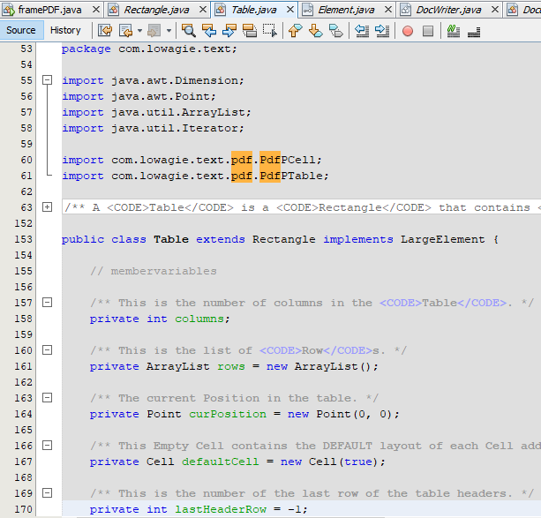
Implement Inheritance Concept
Inherited from Rectangle class
Implement Encapsulation
camelCase

Slide 7
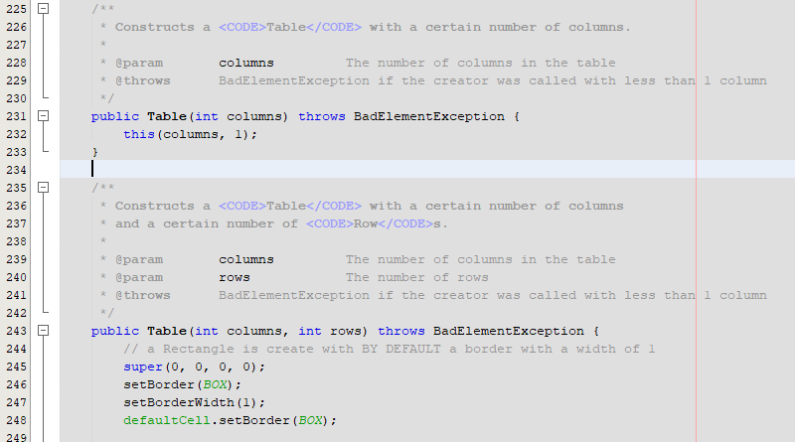
Table Class has Constructor Overloading
Had some usage of Rectangle class method such: setBorder(), setBorderWidth()

Slide 8
File:
Rectangle.java
A Rectangle is the representation of a geometric figure.

Slide 9
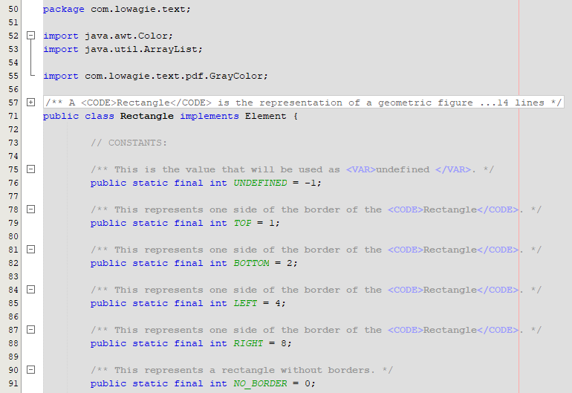
Implement Inheritance Concept
Implement Encapsulation

Slide 10
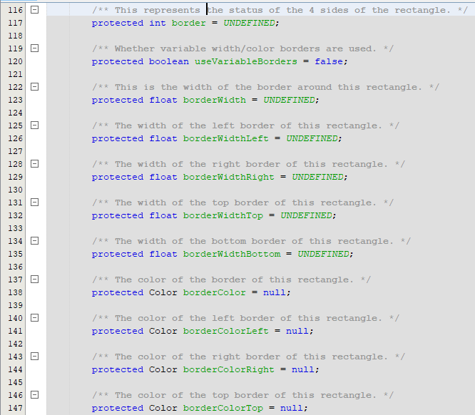
camelCase

Slide 11
Table.class
Rectangle.class

Slide 12
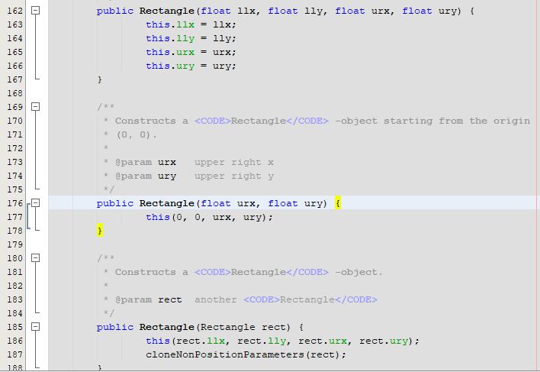
Overloading Constructor

Slide 13
File:
PdfPTable.java

Slide 14
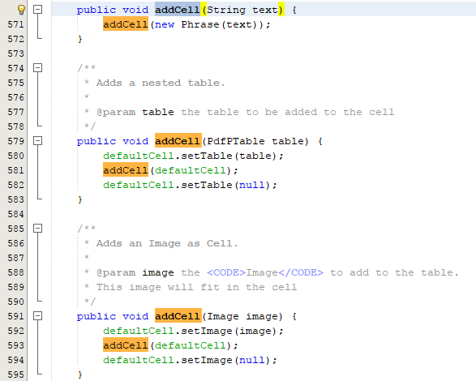
Implement Polymorphism Concept
camelCase

Slide 15

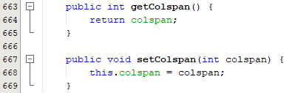
PdfPTable Class
Implement Encapsulation
PdfPCell Class

Slide 16
File:
BaseFont.java
Base class for the several font types supported

Slide 17
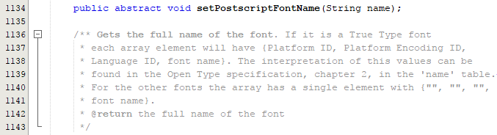

BaseFont Class
Implement Abstraction
camelCase
TrueTypeFont Class

Slide 18
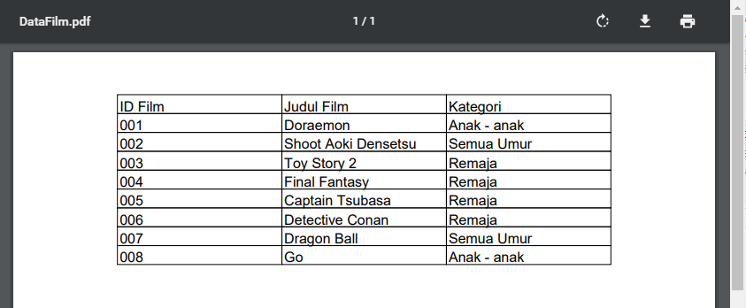
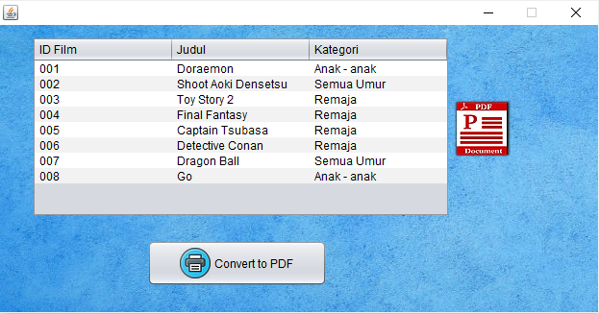
iText Usage in Project
How to use and implement iText library v2.1.7 into the Java SWING Project ?

Slide 19
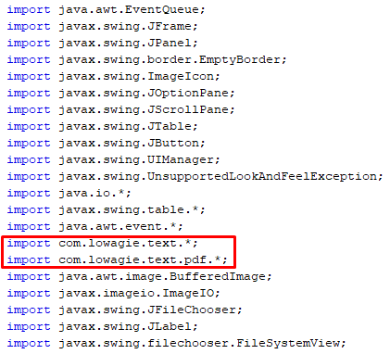
Importing...

Slide 20
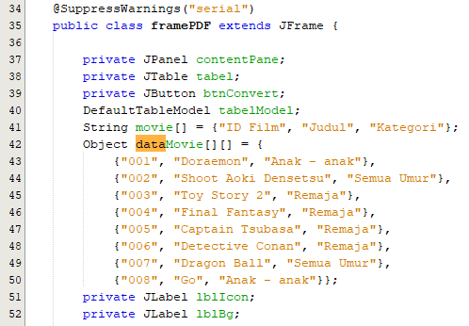
Initialize Variables

Slide 21
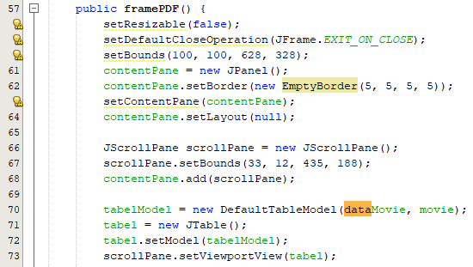
Creating SWING Panel and Table Model

Slide 22
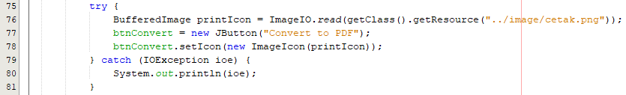
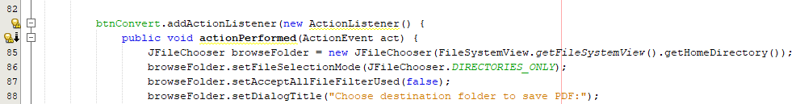
Create Convert Button

Slide 23
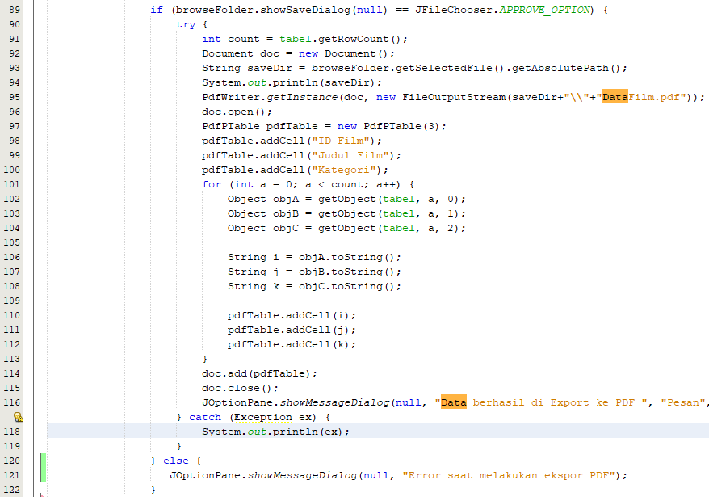
Create Browse Save Folder Dialog

Slide 24
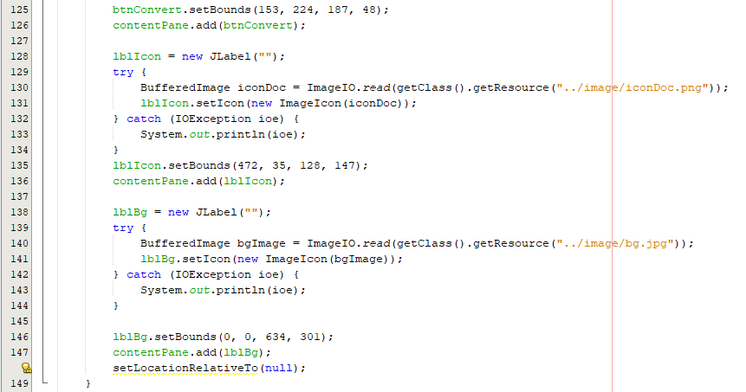
Create Icon and Background and Add Them to Panel

Slide 25
Create getObject() Method

Slide 26
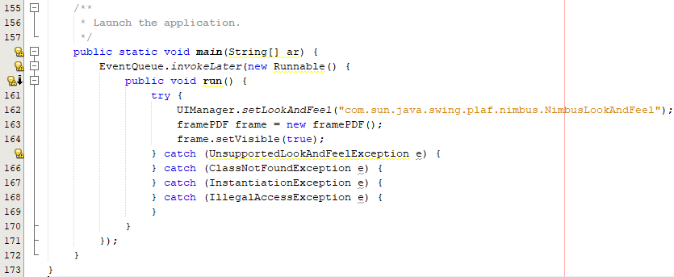
Main

Slide 27
Program Run

Slide 28
Program Run (PDF Result)

Slide 29
The Conclusion
iText adalah salah satu library java yang cukup popular yang dapat digunakan untuk memproses dan manipulasi dokumen dalam bentuk PDF. Library iText yang digunakan dalam analisis kami merupakan versi lama. Class-class pada Library iText mencakup hampir semua konsep Object Oriented seperti abstract, inheritance, polymorphism, dan encapsulation namun lebih banyak penggunaan konsep multiple inheritance dengan memanfaatkan kata kunci interface dan implements serta sebagian code naming convention yang ditulis menggunakan jenis camelCase.

Slide 30
Sources & References:
https://www.lowagie.com
https://marisharingilmu.wordpress.com/tag/java-itext/
https://repo1.maven.org/maven2/com/lowagie/itext/2.1.7/itext-2.1.7-sources.jar

